Slide 1

The Global Treps Project
Anyone can be an entrepreneur

Slide 2

A basic intro
Economic Inequality
X 3.5 billion
Notes:
A recent study has found that 80 of the wealthiest individuals own as much as the entire world’s poorest 3.5 billion people. Furthermore, the richest 1% of the world’s population control about 50% of the world’s total wealth. That is a lot of wealth and power over others being maintained by such a small minority of a minority. With inequalities like this, many new business enthusiasts usually run into many roadblocks that can destroy dreams and hinder the economic growth of a society.

Slide 3

The Global Treps Project
Entrepreneurship
Opportunity
Notes:
The Global Treps Project aims to combat economic inequality while promoting entrepreneurship by creating a non-profit that creates events similar to “Shark Tank” at colleges, high schools and even elementary schools. Why target these three areas specifically? Elementary and high school students are young but filled with vision that is usually dismissed by adults for being outlandish or childish. However, students nowadays are more consistently being taught the value of sustainability while still retaining a sort of wonder and enthusiasm that should be promoted. By coaching students better business practices, marketing and other entrepreneurial skills, this can set them up for success. As for college students, they still retain many ideas entering college with a post-secondary background added on to ensure they can combine both their theoretical knowledge with the aides set by the Global Treps Project.

Slide 4
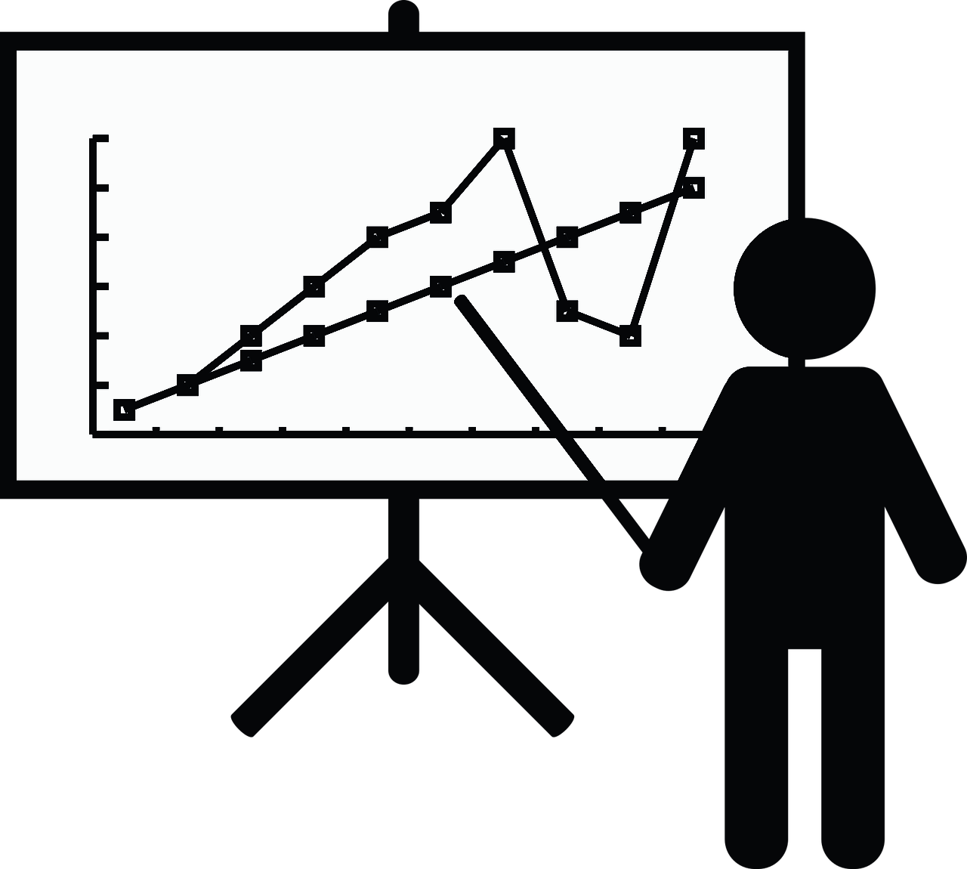
Our Objectives
Promote entrepreneurism
Market your idea
Market yourself
Notes:
The Global Treps project sets out to educate new business owners to achieve our 3 objectives: promote entrepreneurism, to market their ideas, and to market themselves. Shark Tank is setup as a show where entrepreneurs can enter with an idea and gain an investment from one or more of the sharks. But not only that, the Sharks are also industry experts who have knowledge of the business world and contacts can propel an idea, and with tons of experience in marketing their image. Understanding how to run a business is important but market is also a large part of a successful business. The Global Treps project aims to achieve the goal of marketing by providing entrepreneurs with a venue where they are able to present their ideas to possible investors and even if they are not accepted, they can make valuable contacts that can help them grow their business and expand their knowledge.

Slide 5
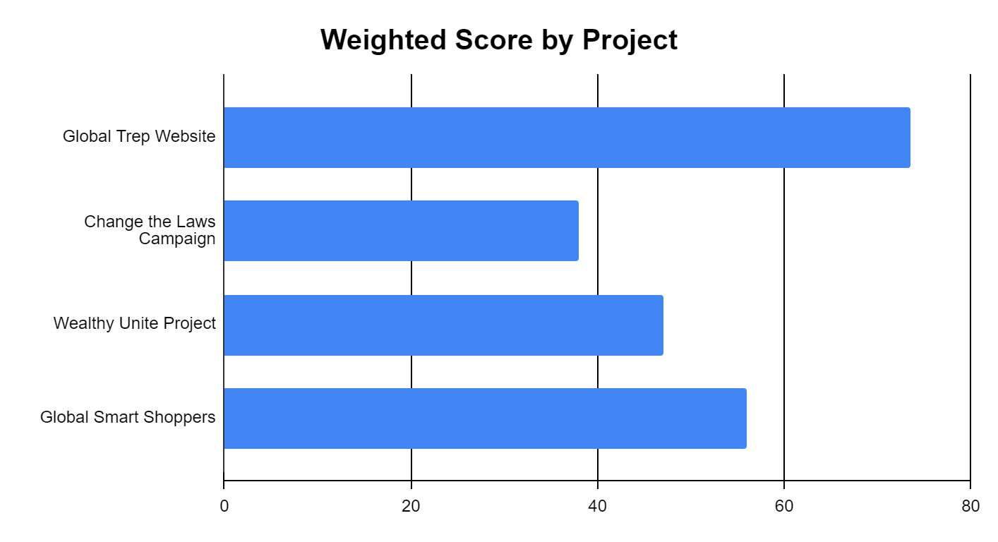
Why the Global Treps Project?
Notes:
But why the Global Treps Project? Why not Change the laws Campaign, the Wealthy Unite Project or the Global Smart Shoppers? After summarizing 4 criteria on how to assess each project, we were able to determine that the Global Treps Project was able to achieve the goals of the group the most. The Global Treps project was able to receive the highest weighted project scores as it’s focus on developing entrepreneur skills and entrepreneurship most closely aligned to the group’s goals. More information on these criteria and the scores can be found in the weighted scoring model spreadsheet as well as a written summary in the corresponding document.

Slide 6

A Little More About the Global Treps Project
Accessibility through an online app
Support through donors
Education through resources
Notes:
The business case we have prepared touches a basic introduction to the idea behind the Global Treps Project and the objectives aimed to be achieved. We have created an estimated budget for the project for about $120,000 that will cover hardware necessary to run the project as well as any software necessary for the creation and maintenance of the application. Furthermore, the budget also includes travel expenses to create starting events and the necessary labour to get it off the ground. With the world being so connected through the internet either on a computer or a phone, an application utilizes this to provide access to a larger audience while not requiring a team member to be present. Through the app, we can provide quick and easy access to resources which can help us educate future entrepreneurs about the principles of entrepreneurship, the principles of business and help them market themselves and their ideas. Furthermore, the application gives access for potential investors and speakers to see what we provide as a project and how, if they wish to, they can also participate.

Slide 7

Our Approach
Templates and guidelines for running events
Visual and audio resources
Aid for other organizations to build from our ideas
To accept donations towards schools and organizations to host their own event
Notes:
Our approach is simple, through templates and guidelines, we can help streamline and shorten the creation process of future events where organizers and start with our material as a base. Furthermore, our application will provide visual and audio resources in the form of documents and videos on how to use the site, to creating events and how to approach potential sponsors. Through the application, we can streamline the contact process by connecting organizers with potential sponsors directly. And with these resources, we can provide other organizations with the ability to create their own custom sites and events and the promotion of participants.

Slide 8

Estimated Timeline

Slide 9
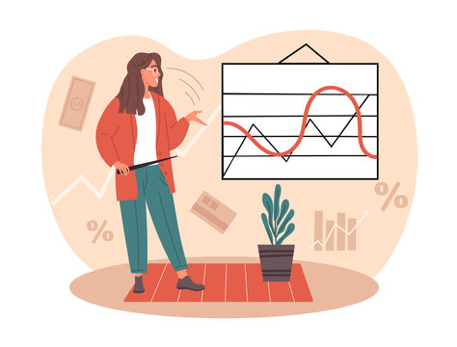
Initiating/Planning/Execution/Closing

Slide 10
What is the Future?
Notes:
What will the next steps be? Well, the start will be the setup of the team and implementation of the project. The four events will help to identify issues that we may run into and help build relationships with sponsors for the long-term. Although 6 months is estimated for the implementation of the application, this project will require continuous maintenance and further analysis into the success of the project and any necessary changes.

